Slide 1
Go
Wenzhe Liu

Slide 2
Outline
Introduction
Gramma
Concurrency
Libraries & tools
Integrate/compare with other languages

Slide 3
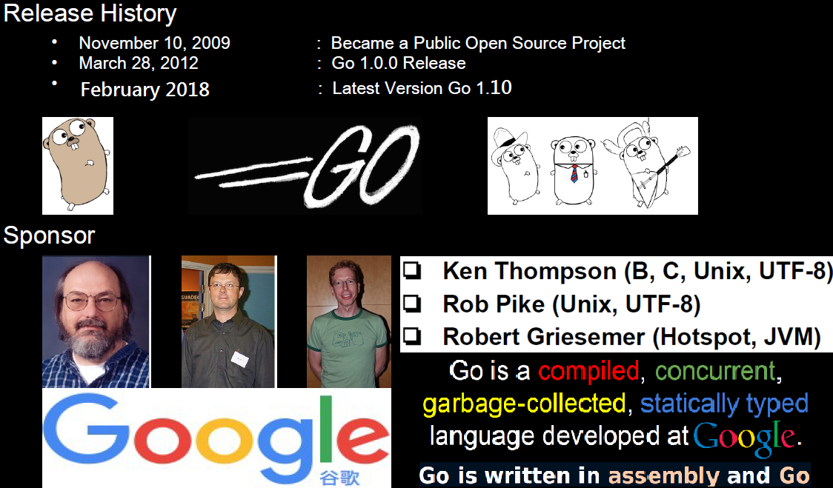
Notes:
Tool:
Debug: gdb, dlv
IDE: Goland, LiteIDE, vim

Slide 4
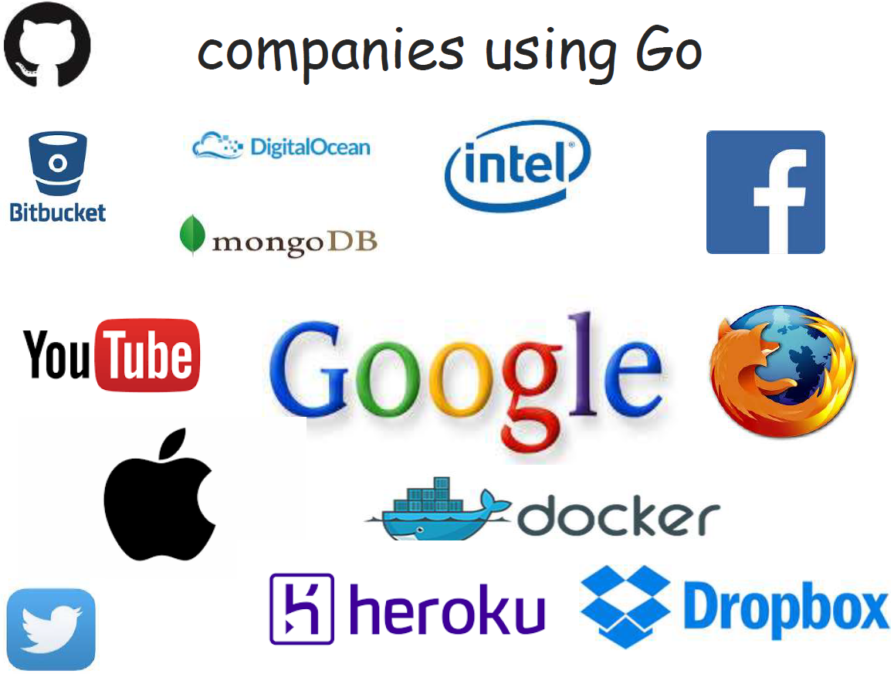
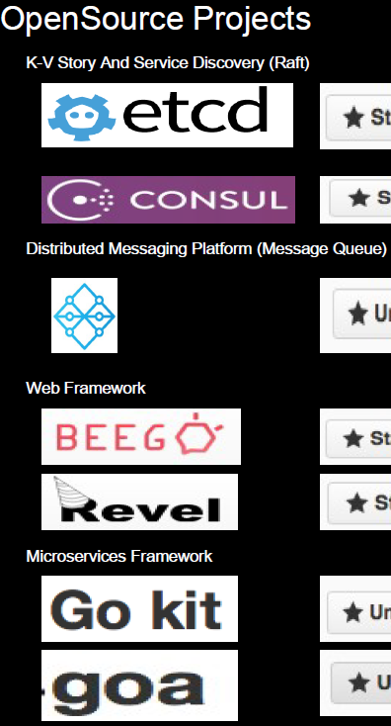


Slide 5
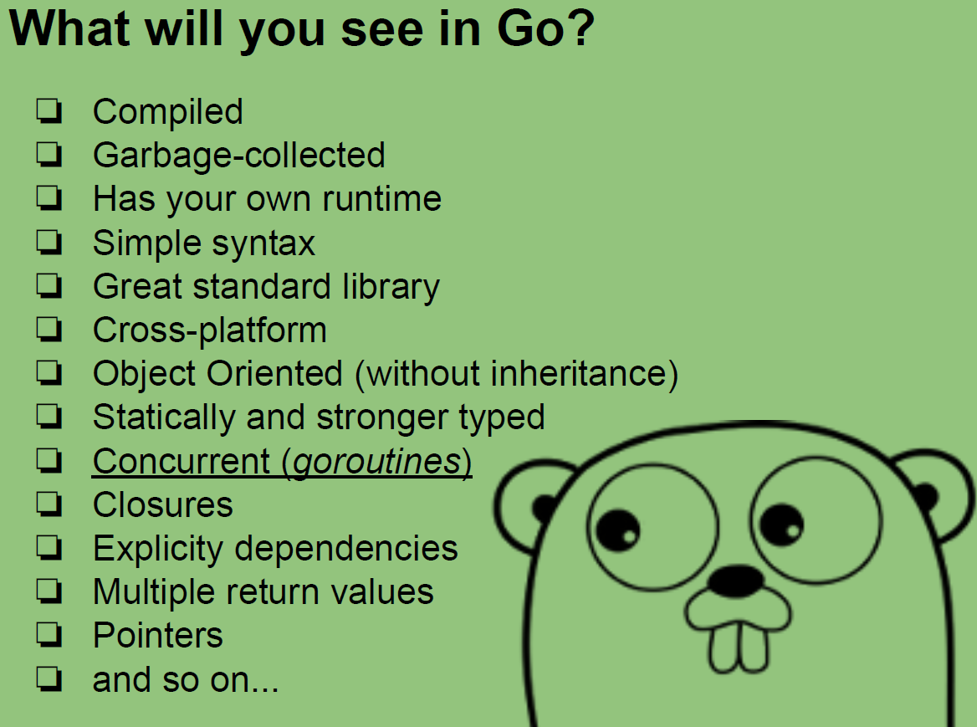
(like C/C++)
High run performance
(like C/C++)
(like Java)
(like Python)
High develop efficiency
(like Python)
(like Python)
(like C/C++)

Slide 6
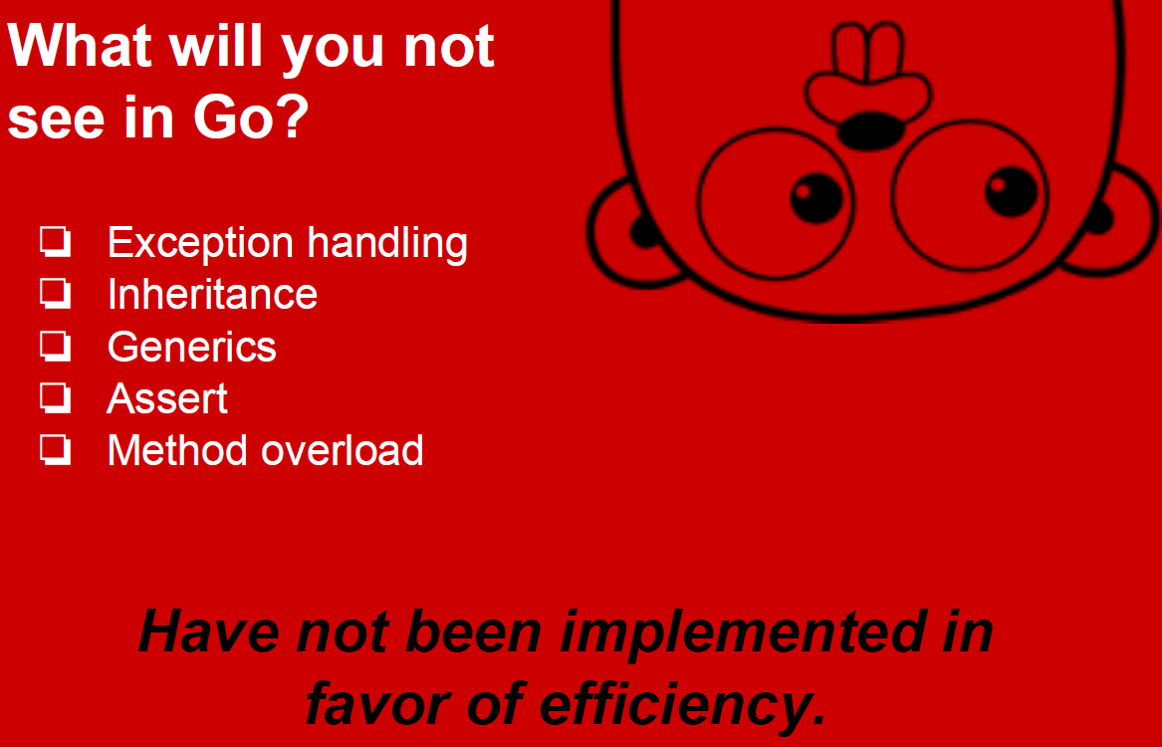
Keep it Simple!

Slide 7
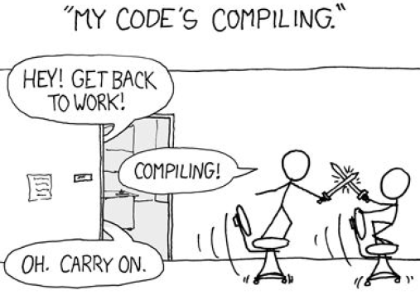
Quickly Compiled
Compile Go application is much faster than C/C++/Java/Scala, take only 1-5 seconds.

Slide 8
Outline
Introduction
Gramma
Concurrency
Libraries & tools
Integrate/compare with other languages

Slide 9
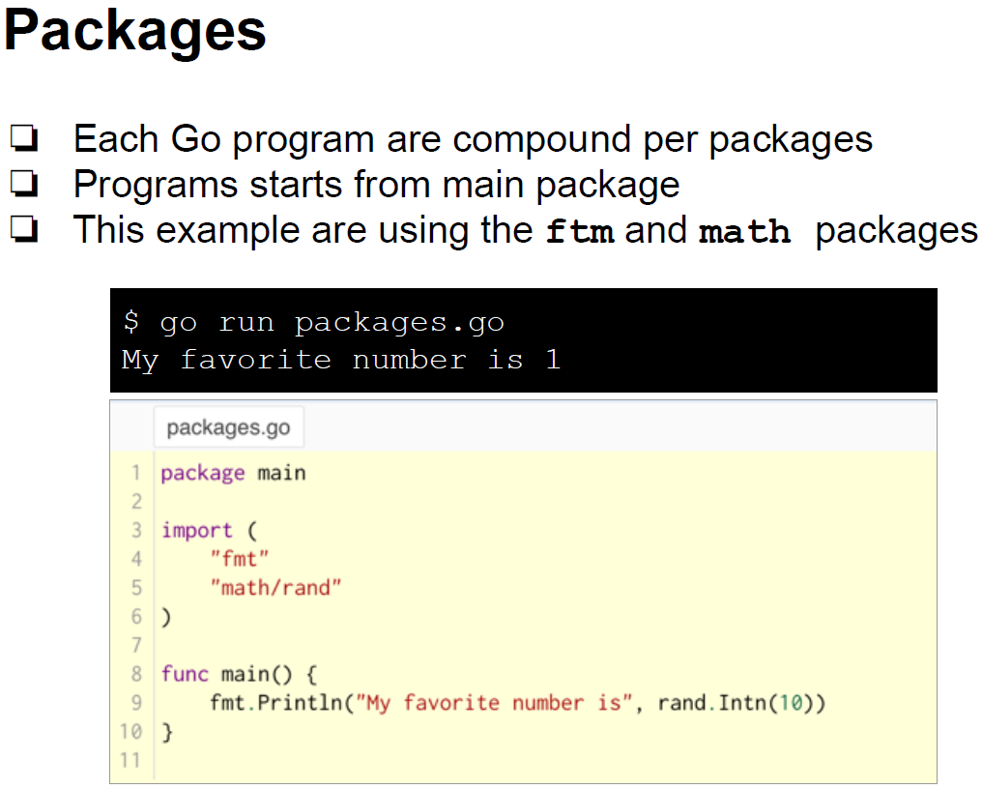

Slide 10
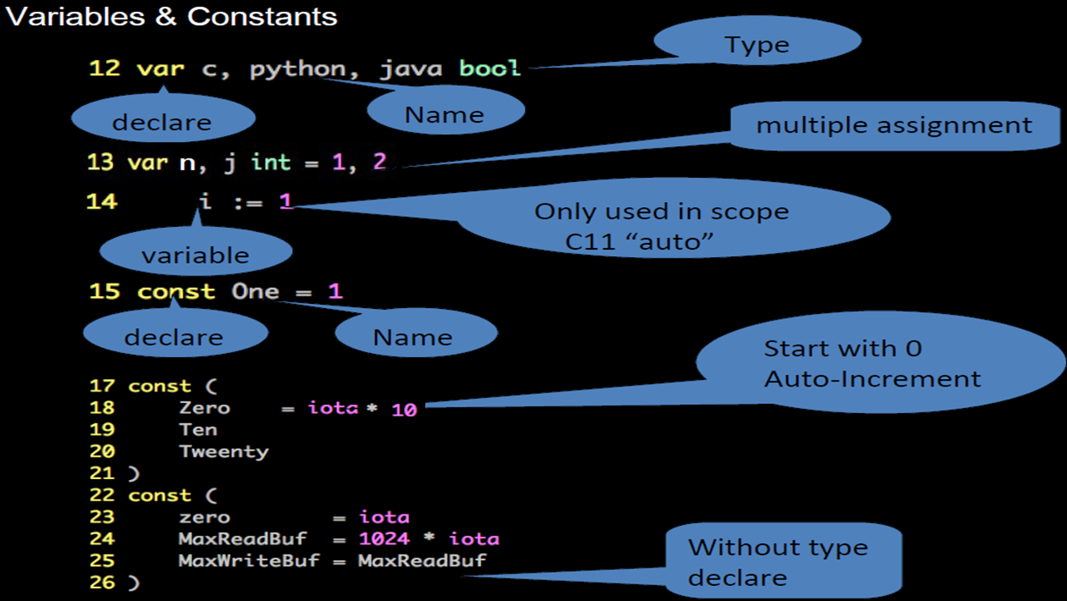

Slide 11
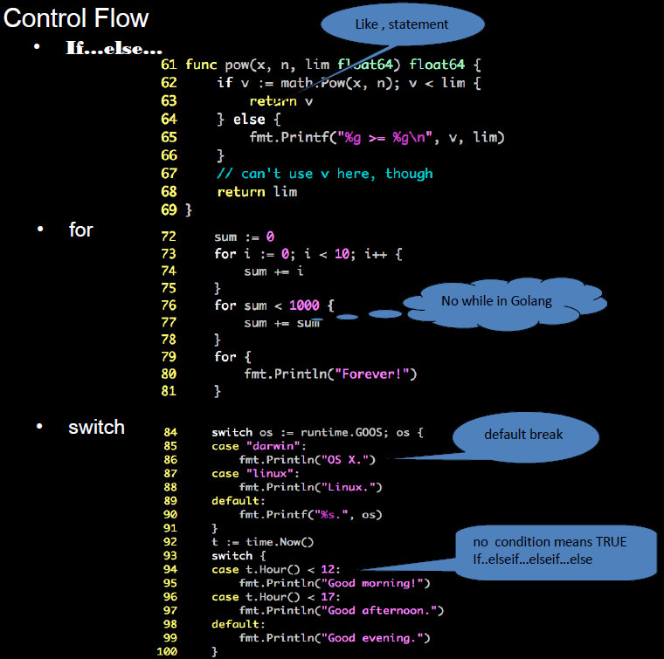

Slide 12
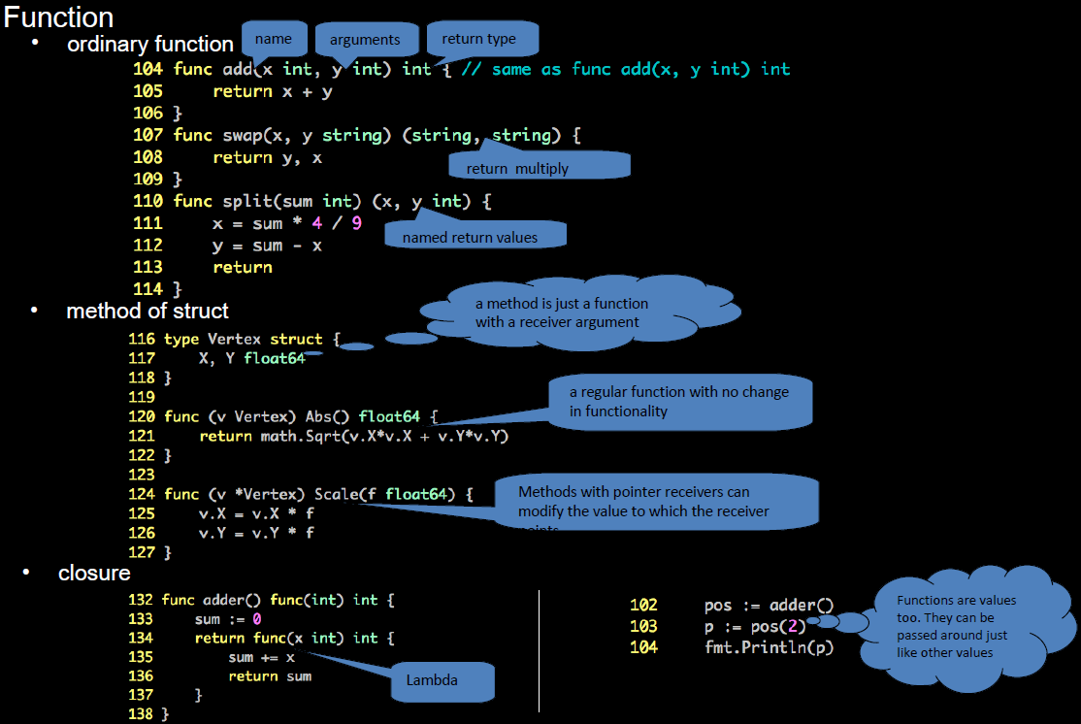

Slide 13
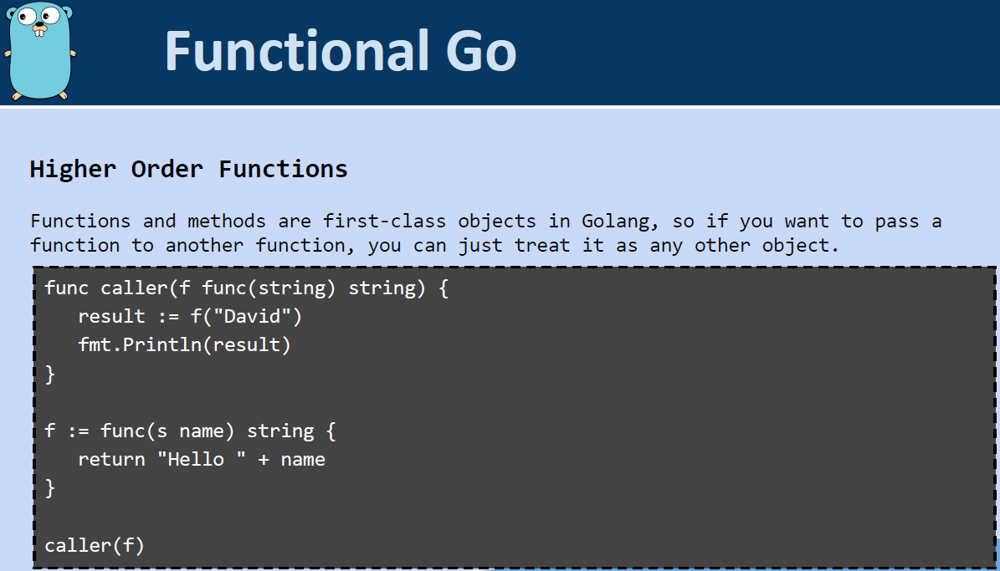

Slide 14
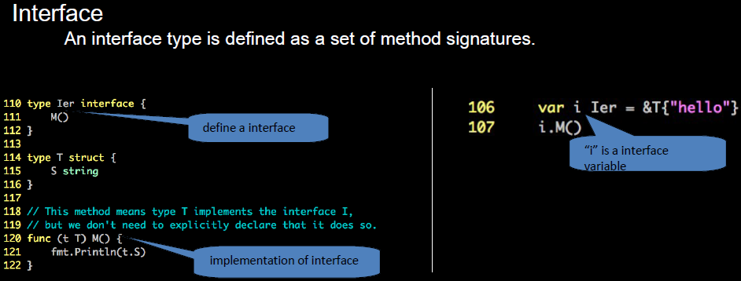
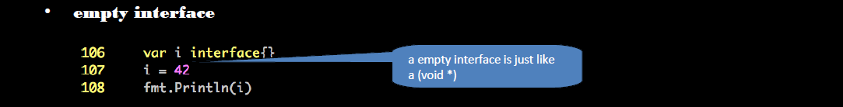

Slide 15
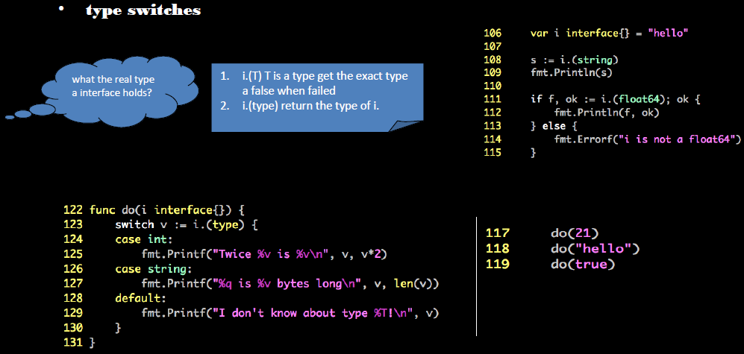

Slide 16
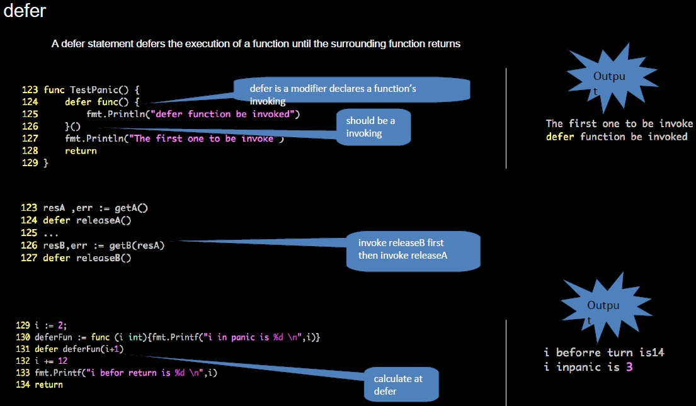

Slide 17
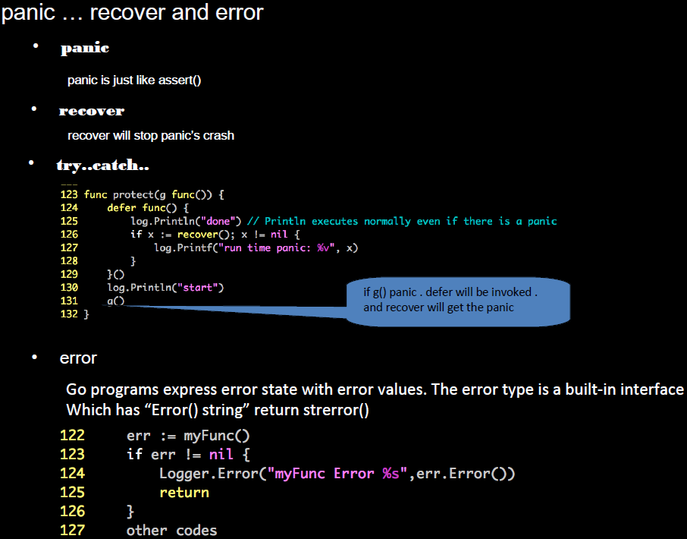
func g() {
panic(“reason”)
// should not reach
}

Slide 18
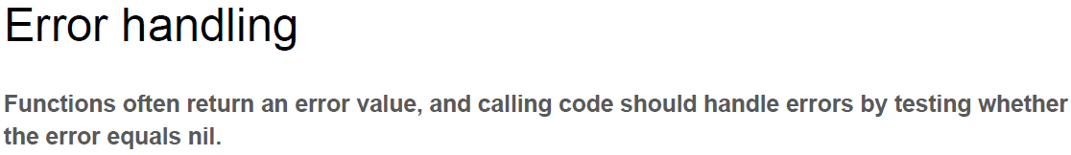
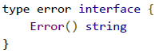
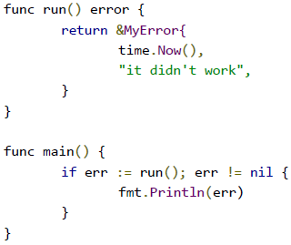
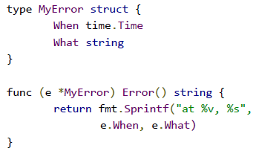

Slide 19
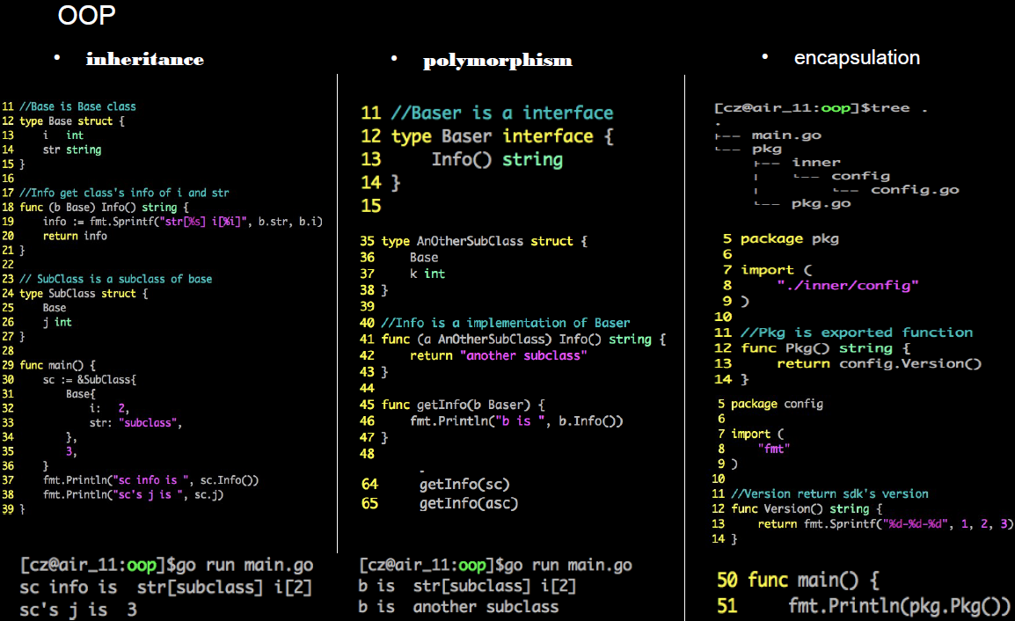

Slide 20
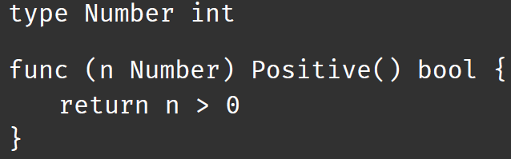
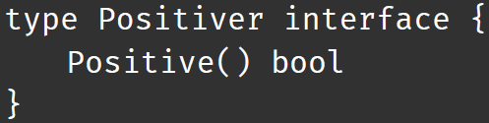
New type can be an alias to other type
Interfaces are satisfied implicitly.
var p Positiver = Number(3)
p.Positive()

Slide 21
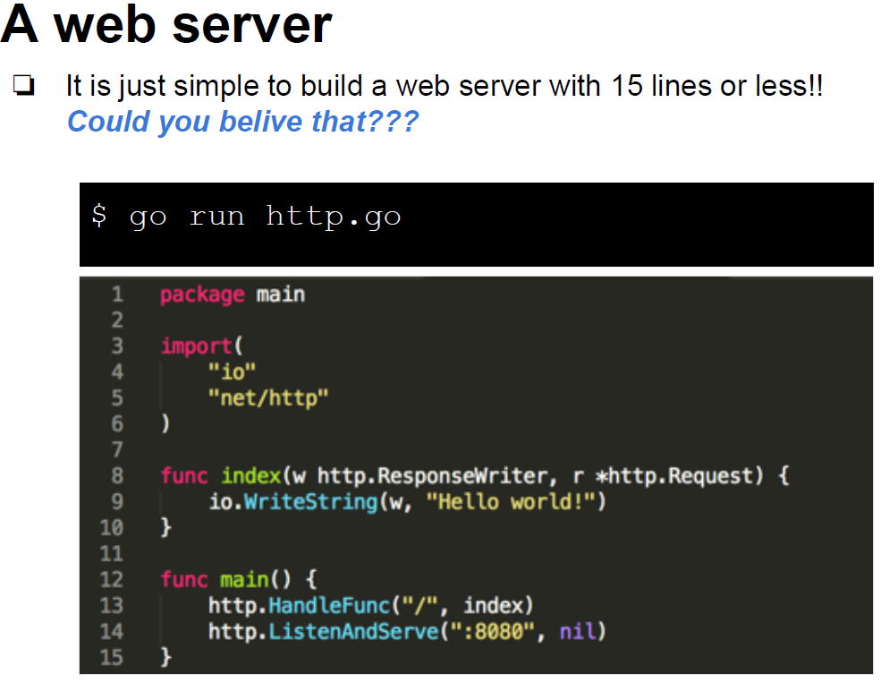

Slide 22
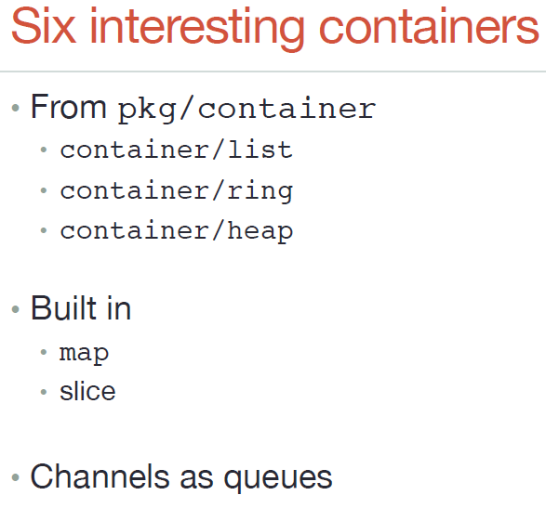
Doubly-linked list implementation
A circular ‘list’
Implements a “min-heap”
Hash map
Array list

Slide 23
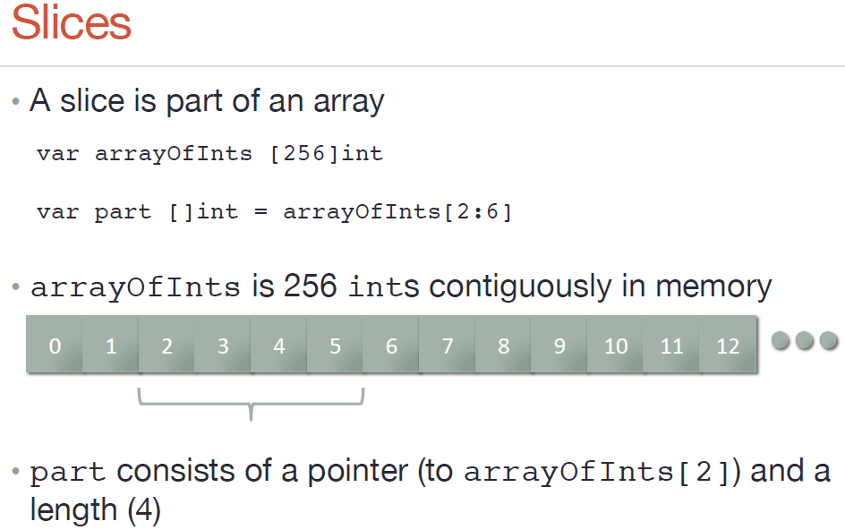
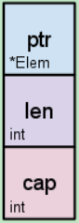

Slide 24
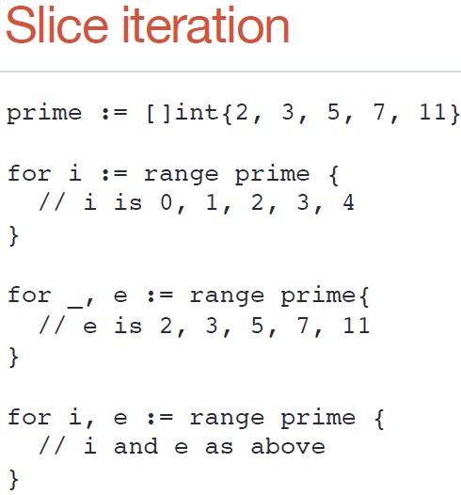
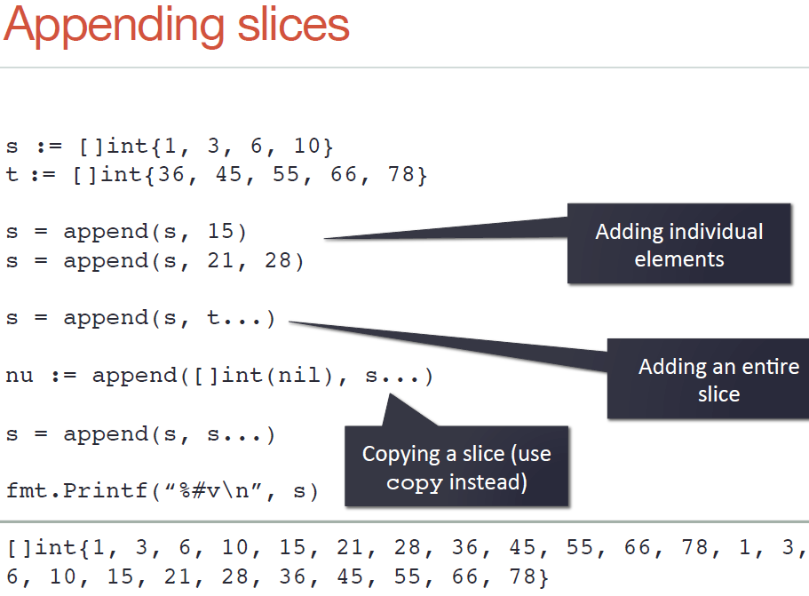

Slide 25
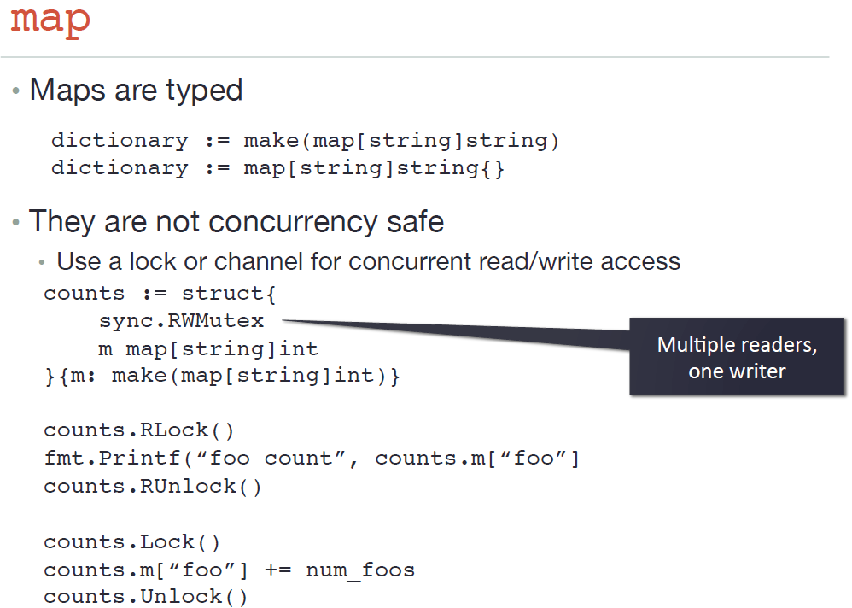

Slide 26
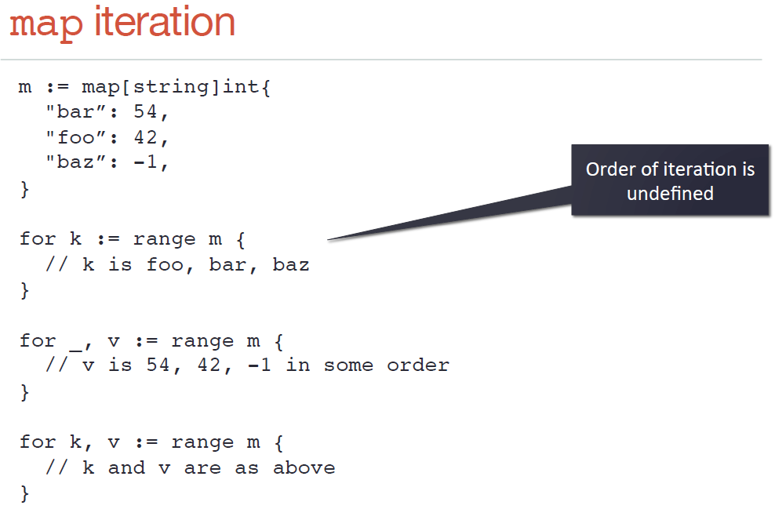
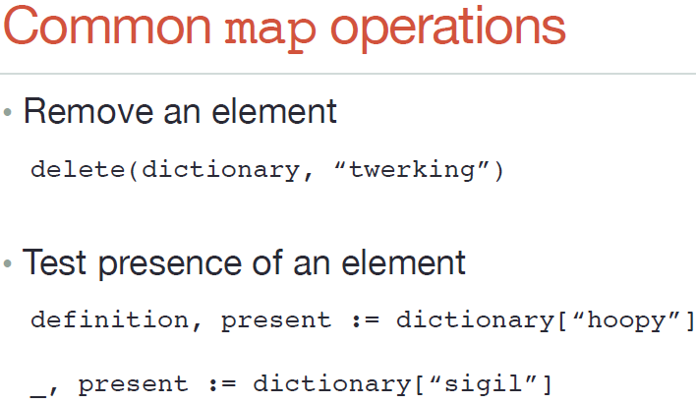

Slide 27
Outline
Introduction
Gramma
Concurrency
Libraries & tools
Integrate/compare with other languages

Slide 28
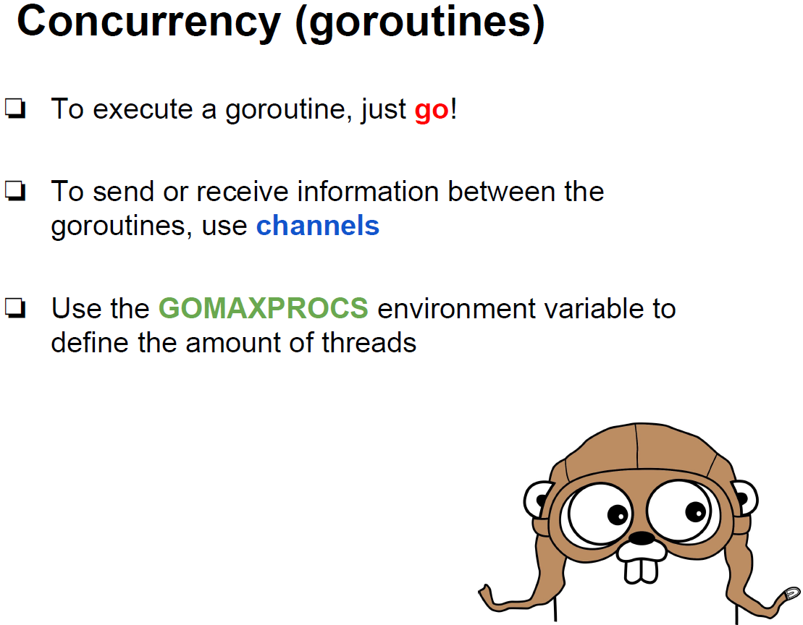
Default: Number of CPU cores

Slide 29
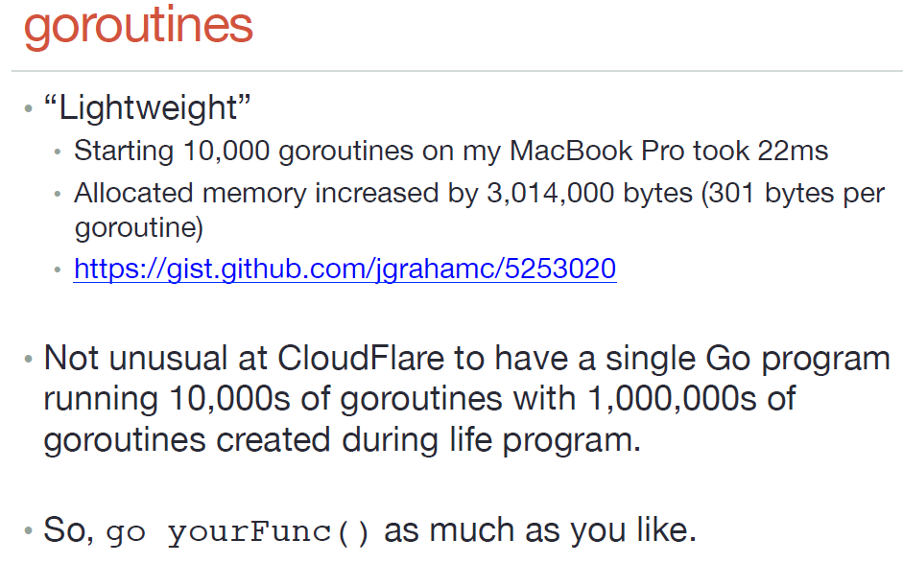

Slide 30
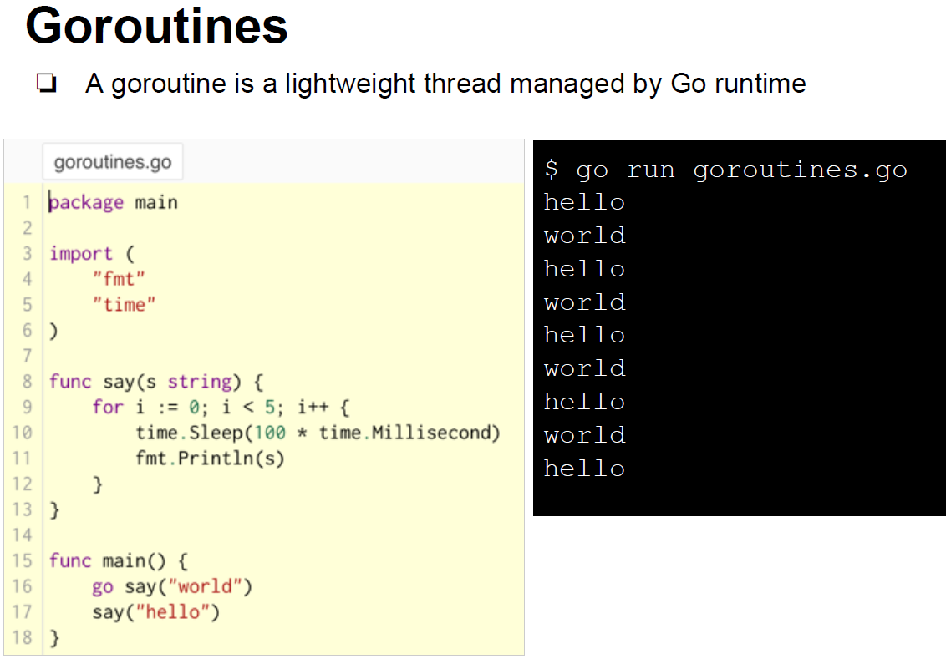

Slide 31
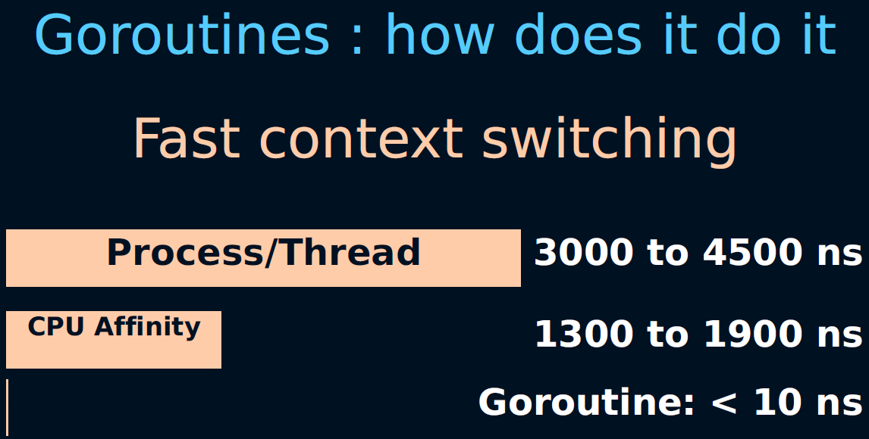

Slide 32
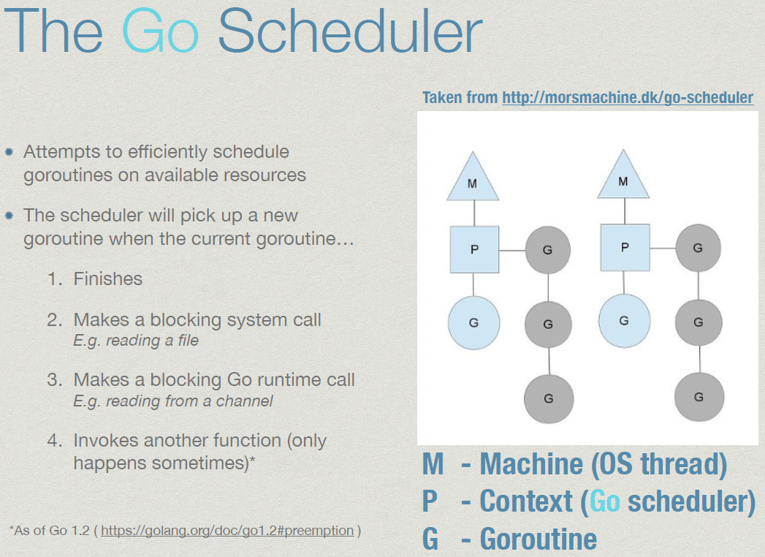

Slide 33
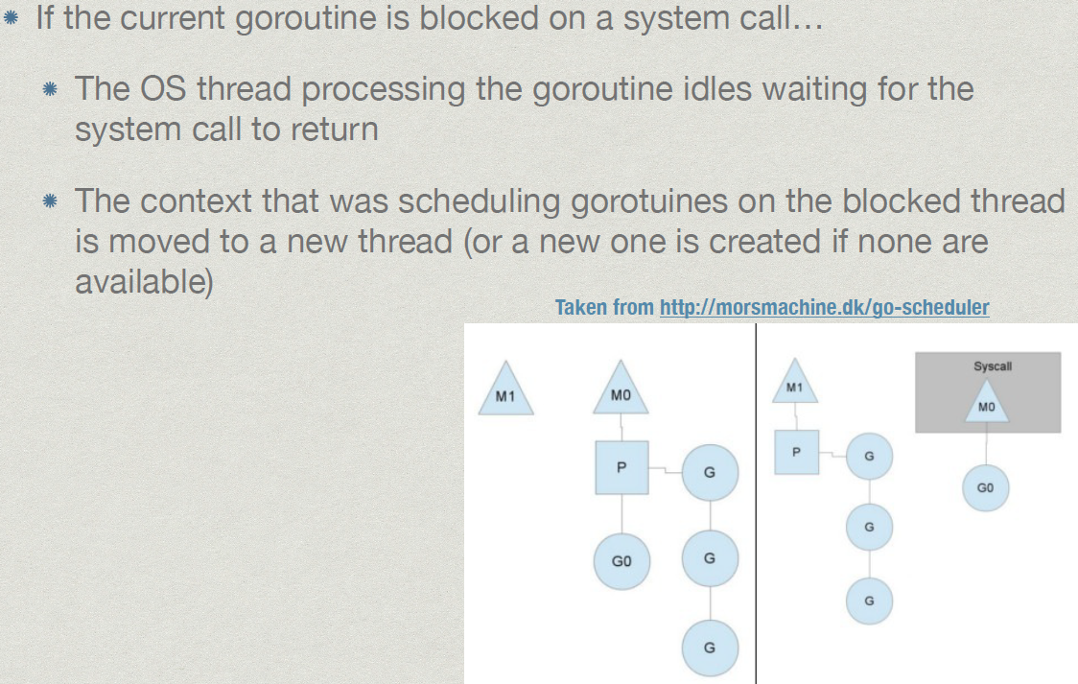

Slide 34
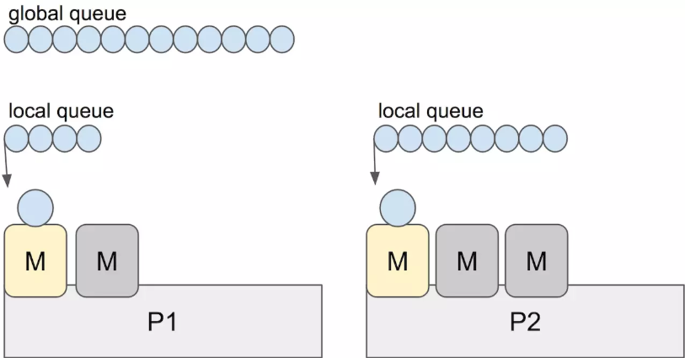
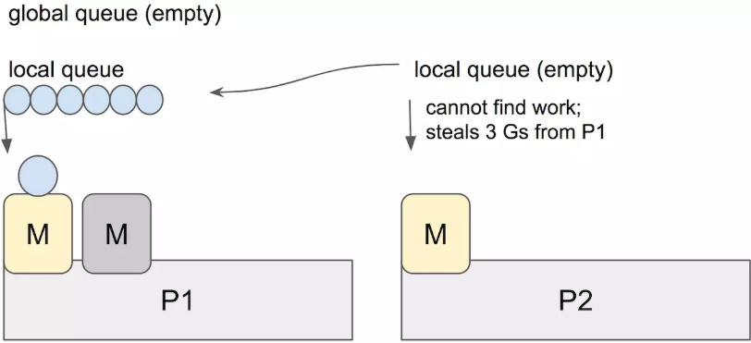
Work Stealing Scheduler
1. Work sharing
After creation of new threads, a process attempts to migrate some of them to the other processors.
2. Work stealing
An underutilized processor actively looks for other process's threads and steal some.
3. Spinning threads
The runtime prefers to burn some CPU cycles rather than preemption of the thread

Slide 35
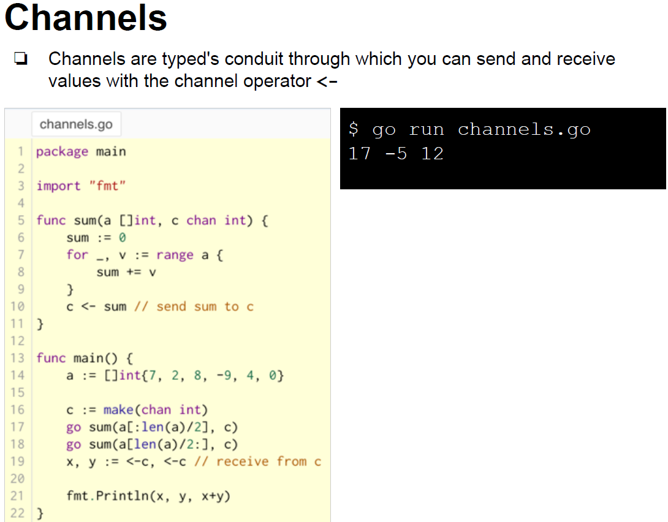

Slide 36
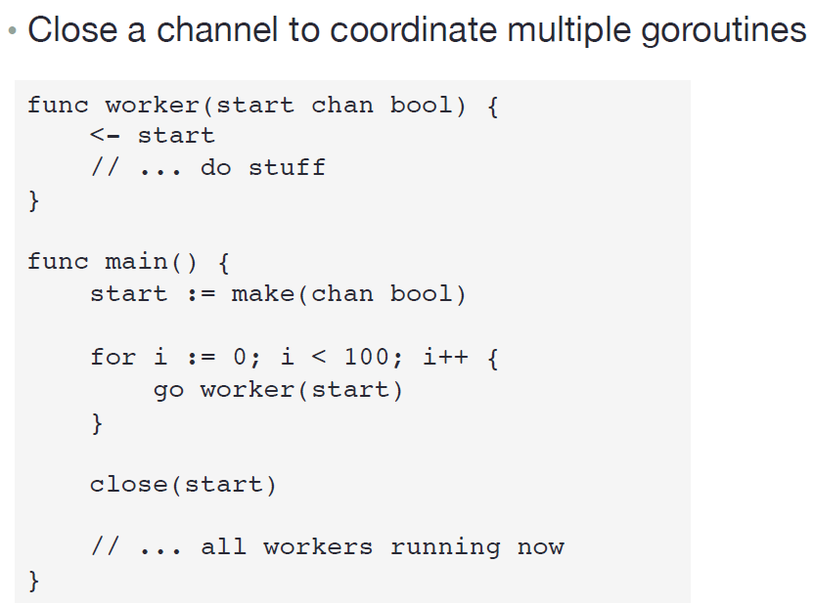

Slide 37
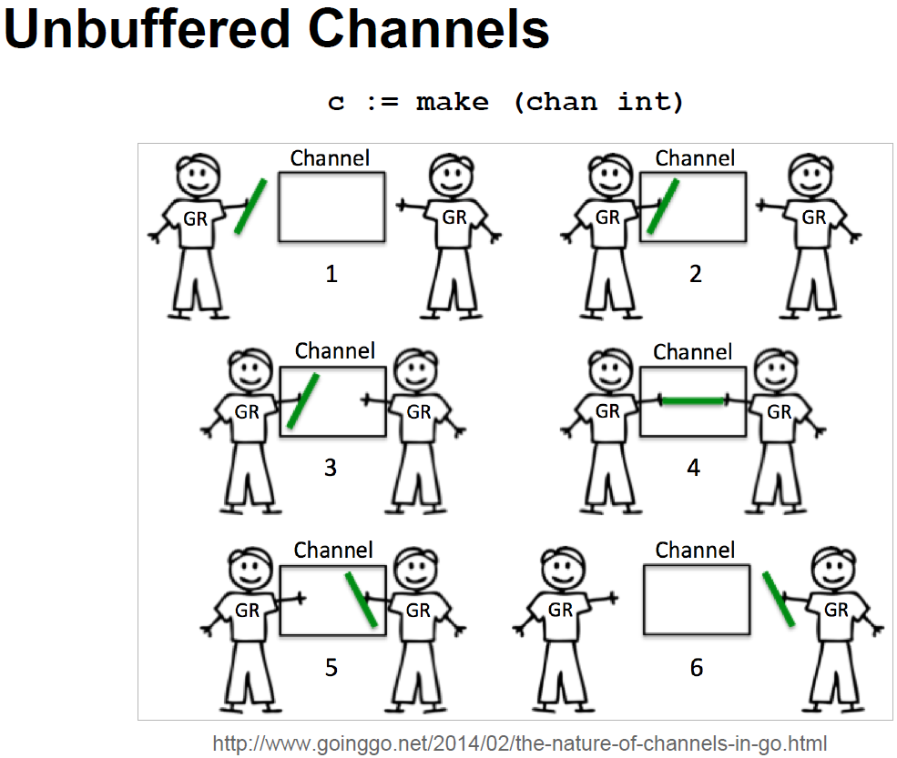
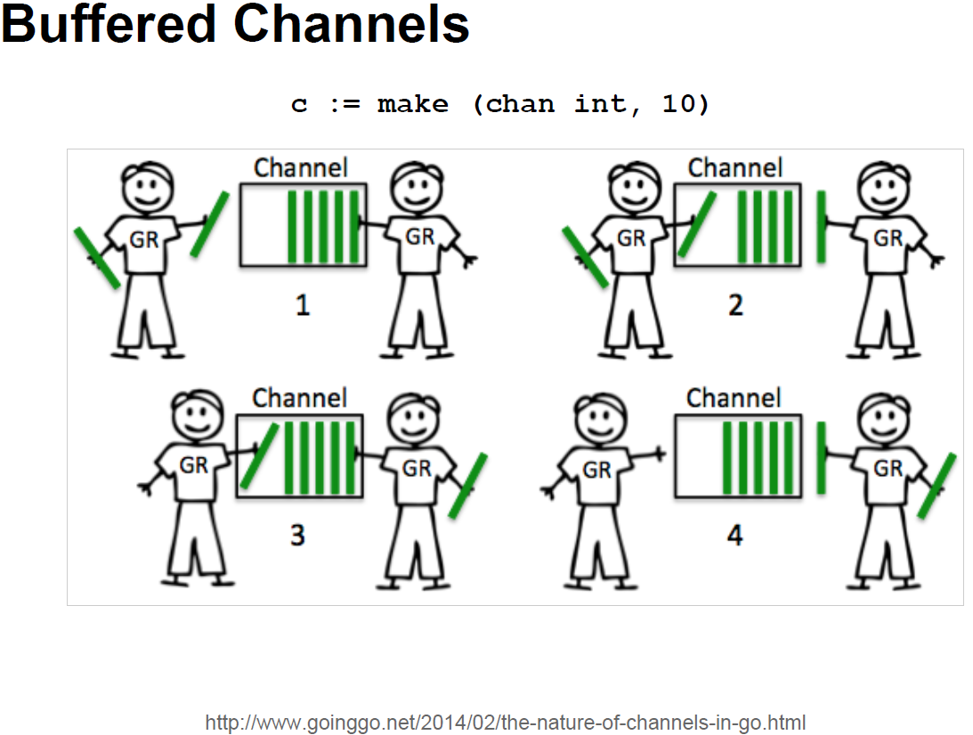

Slide 38
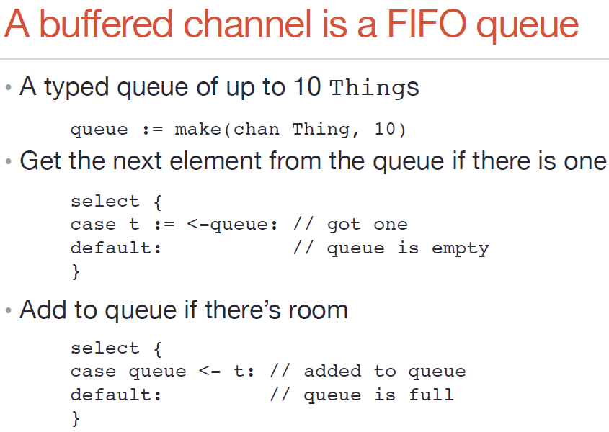

Slide 39
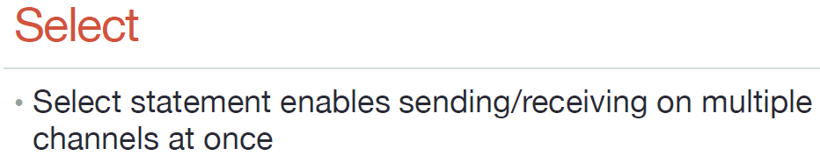
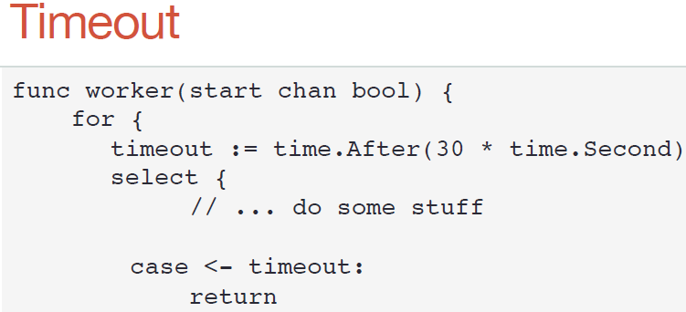
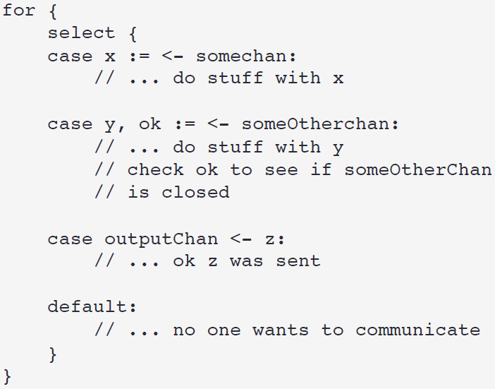
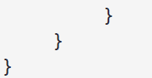
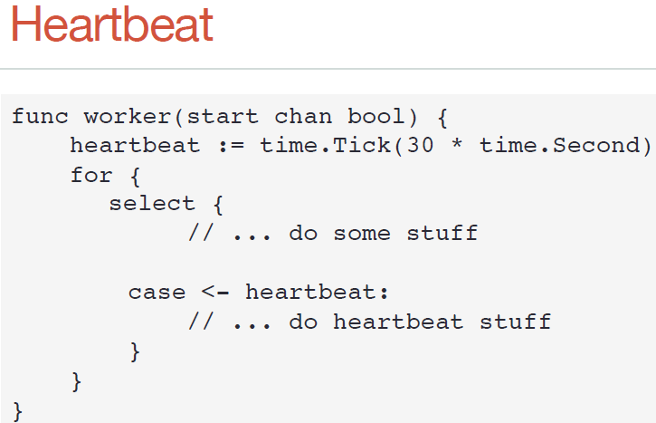

Slide 40


Don’t have to lock anything

Slide 41
Outline
Introduction
Gramma
Concurrency
Libraries & tools
Integrate/compare with other languages

Slide 42







Powerful Standard Library

Slide 43


Convention Over Configuration
No Make file
multi-arch build without pre-processors:
xx_linux.go
xx_windows.go

Slide 44





Slide 45





IDE
Goland

Slide 46
Outline
Introduction
Gramma
Concurrency
Libraries & tools
Integrate/compare with other languages

Slide 47


Slide 48


Slide 49


Slide 50

Go VS C/C++, Java, Python, …

Slide 51


Go missing parts (by intention…)
No inheritance
No constructors
No classes
No implements
No final
No exceptions

Slide 52

Summary: Go
High running performance (like C/C++)
Safe memory management and garbage collection (like Java)
Fast develop and write less code (like Python)
Strongest Parallel Support (Go-routine: easy to support 10000+ parallel)
Advanced Parallel communication model (Go channel)
Easy to maintain (type safe, great IDE support)
Easy and very fast build, test and deploy (no make file, only one command to build: go build or go install, no .so need, build fast)
Orient Interface Program (duck type)
Easy to learn (less grammar, very similar to C and Python)
Powerful 3rd party libraries and community, and Google Inc.
Success products: Docker, Kubernetes…

Slide 53
Learning materials
https://golang.org/
https://golang.org/doc/
An Introduction to Programming in Go
Introducing Go
Go Web Programming
Programming in Go
Go in Action
Go语言编程
Go语言学习笔记

Slide 54


